Slide 1

Do you have a long term condition?
Have you heard about personalised care and support planning?
This gives you the chance to have more information and be more involved in your healthcare
©Year of Care Partnership – August 2024 V2

Slide 2
So what does this mean for me?
Your personalised care and support planning review may take place over two appointments.
At the first appointment:
You may be asked to attend the surgery to have all your tests and checks done with a healthcare assistant.
Shortly after this your test results will be sent to you.
©Year of Care Partnership – August 2024 V2

Slide 3
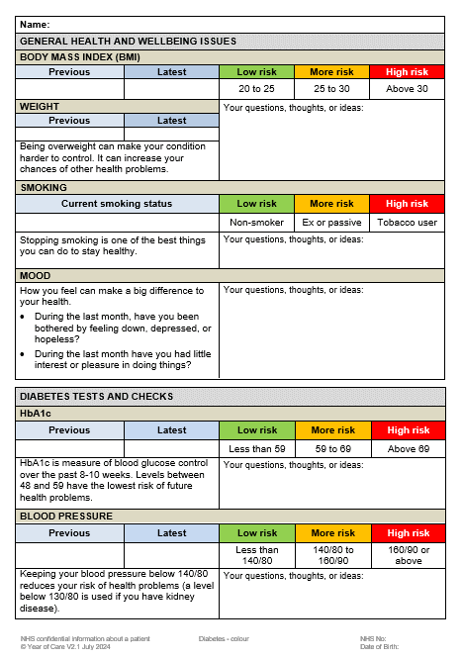
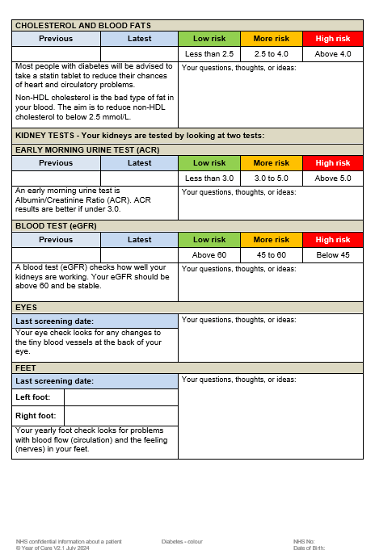
You will be sent a preparation prompt with your results.
This can help you think about what you want to talk about.
©Year of Care Partnership – August 2024 V2

Slide 4
Some of the things you might want to think about before your appointment include:
Feeling down or stressed
Eating the right amount
Giving up smoking
Coping with my day-to-day health
Alcohol
Keeping active and getting around
Relationships/sex life
My future health
Feeling lonely
Sleep
Medication
Memory
Food choices
Pregnancy and contraception
Driving/Travel
Work/benefits/money
Pain/discomfort
Managing my symptoms
©Year of Care Partnership – August 2024 V2

Slide 5

Personalised care and support planning appointment
You will be able to discuss your results and talk about what is important to you.
By the end of your appointment, you will have a plan that has been agreed.
For more information on personalised care and support planning, please visit:
www.yearofcare.co.uk/living-with-long-term-condition
©Year of Care Partnership – August 2024 V2

